Slide 1
Orthogonality and Least Squares
5.4 The Gram-Schmidt Process
Bumhee Cho

Slide 2
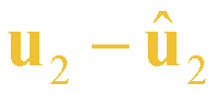
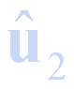
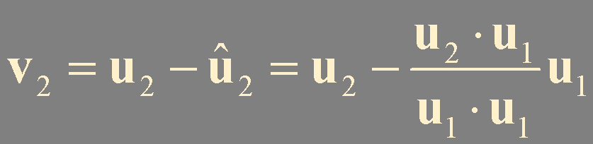

Basic Idea for the Gram-Schmidt Process
{u₁, u₂} is a basis for W = Span {u₁, u₂}
u₂
nonzero
u₁
0
v₁ is in W
v₂ is in W
orthogonal
linearly independent
W = Span {v₁, v₂} = Span {u₁, u₂}

Slide 3

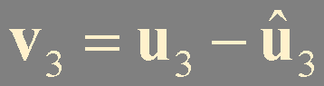
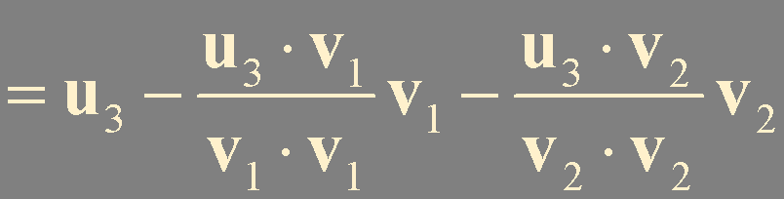
{u₁, u₂, u₃} is a basis for W = Span {u₁, u₂, u₃}
nonzero
u₃
W = Span {v₁, v₂, v₃} =Span {u₁, u₂, u₃}
v₃
v₂
u₂
0
W₂ = Span {u₁, u₂}
u₁
= Span {v₁, v₂}
= v₁
v₃ is in W
orthogonal
linearly independent

Slide 4
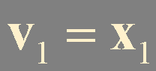
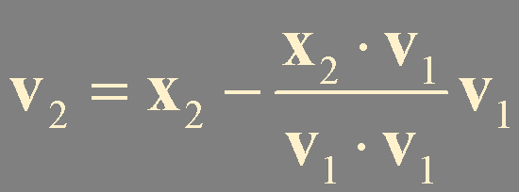
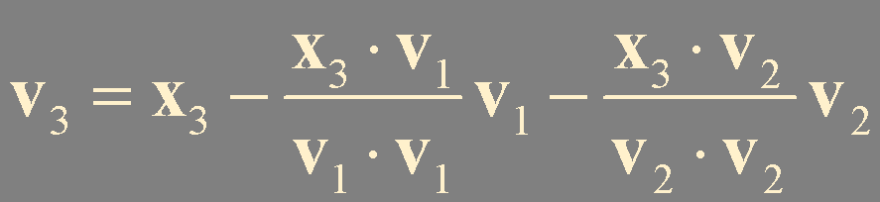
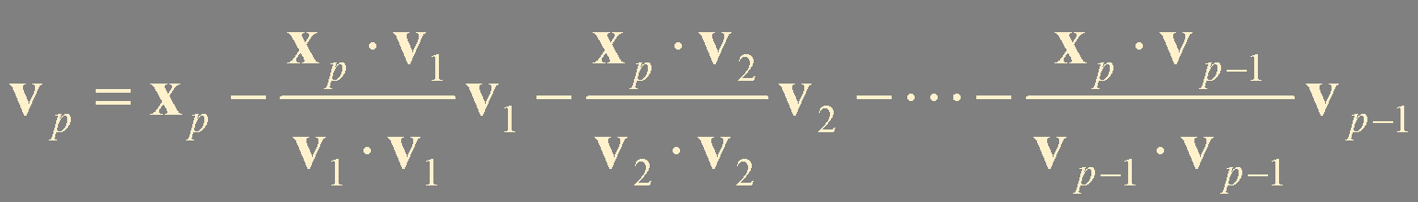
Theorem 11. The Gram-Schmidt Process
Given a basis {x₁,…, x_{p}} for a subspace W of ℝ^{n}, define
v_{j}
cv_{j}
linear combination of x₁
x₁, x₂
v_{i}⋅v_{j} = 0
x₁, x₂, x₃
v_{i}⋅cv_{j}
= c(v_{i}⋅v_{j}) = 0
⋮
x₁, x₂, … , x_{p}
when c = -1
Then {v₁,…, v_{p}} is an orthogonal basis for W. In addition
Span {v₁,…, v_{k}} = Span {x₁,…, x_{k}} for 1 ≤ k ≤ p

Slide 5


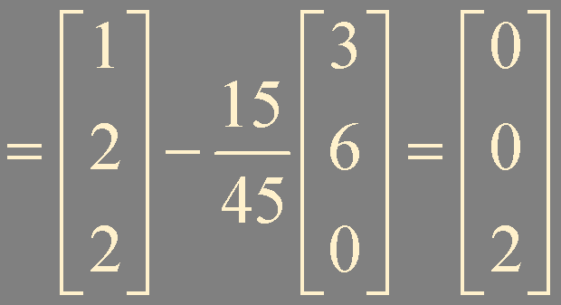
!
Example 1
?
Let W = Span {x₁, x₂}, where x₁ = (3, 6, 0), x₂ = (1, 2, 2). Construct an orthogonal basis {v₁, v₂} for W.

Slide 6
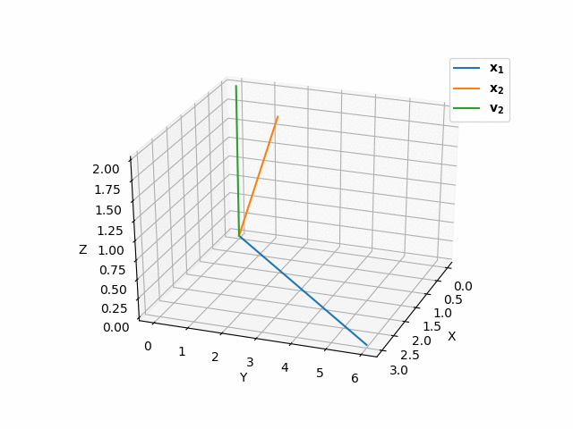

Slide 7

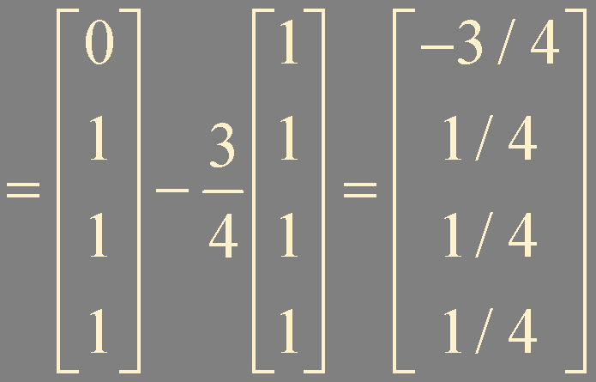
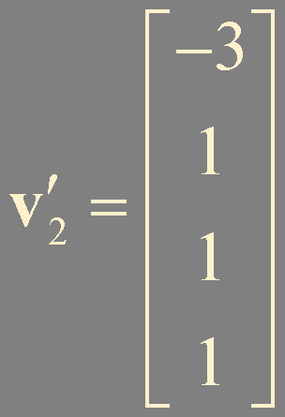
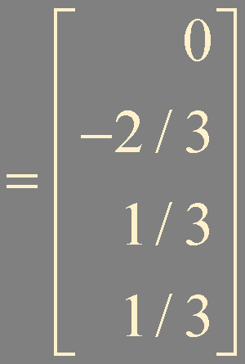
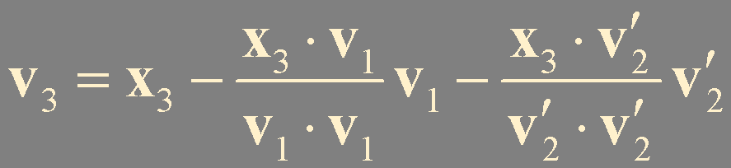
!
Example 2
?
Let W = Span {x₁, x₂, x₃}, where x₁ = (1, 1, 1, 1), x₂ = (0, 1, 1, 1), and x₃ = (0, 0, 1, 1). Construct an orthogonal basis for W.
{x₁, x₂, x₃} is a linearly independent set

Slide 8
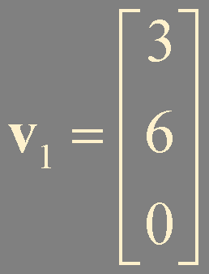
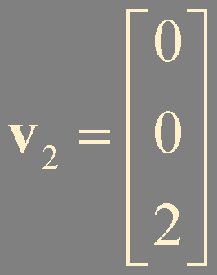
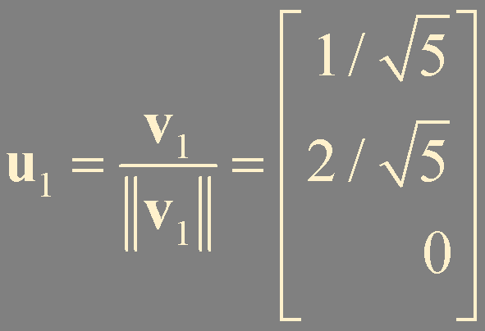
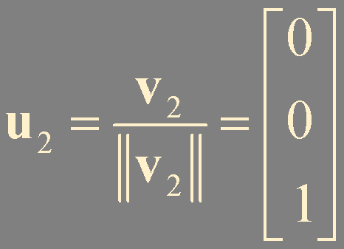
Orthonormal Bases
Given {v₁,…, v_{p}} orthogonal basis for W
Normalize !
v_{k}
(1 / ||v_{k}|| ) v_{k}
?
Example 3
!
Let W = Span {x₁, x₂}, where x₁ = (3, 6, 0), x₂ = (1, 2, 2). Construct an orthonormal basis {u₁, u₂} for W.

Slide 9
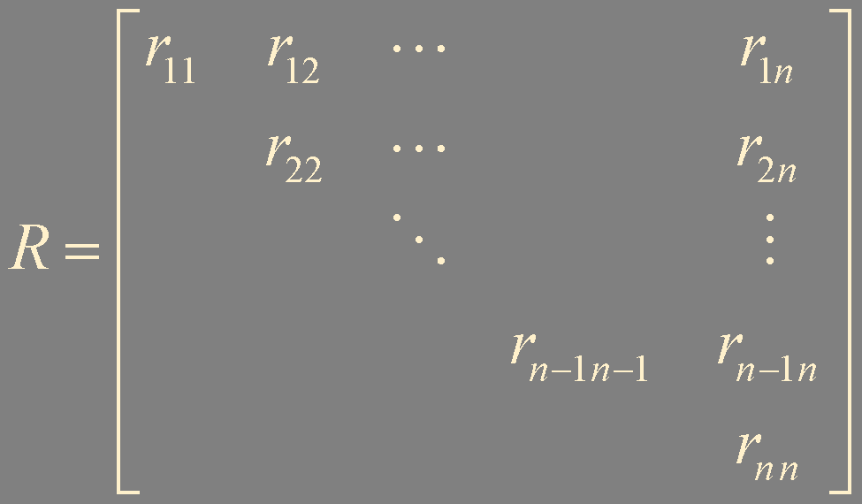
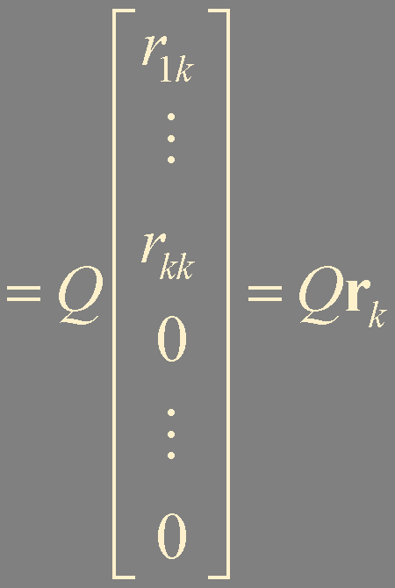
QR Factorization of Matrices
m × n matrix A
linearly independant columns
A = [x₁ x₂ ⋯ x_{n}]
a basis for Col A: {x₁,…, x_{n}}
a orthonormal basis for Col A: {u₁,…, u_{n}}
the Gram-Schmidt
Q = [u₁ u₂ ⋯ u_{n}]
x_{k}: linear combination of u₁, … , u_{k}
x_{k} = r_{1k}u₁ + r_{2k}u₂ + ⋯ + r_{kk}u_{k}
+ 0u_{k+1} + ⋯ + 0u_{n}
Constraint
A = [x₁ x₂ ⋯ x_{n}] = Q[r₁ r₂ ⋯ r_{n}] = QR
If r_{kk} < 0
(-r_{kk})(-u_{k})
Rc = 0
QRc = Q0 = 0
Ac = 0
R is invertible
only trivial solution

Slide 10
Theorem 12. The QR Factorization
If A is an m × n matrix with linearly independent columns, then
A can be factored as A = QR, where Q is an m × n matrix whose columns form an orthonormal basis for Col A and R is an n × n upper triangular invertible matrix (with positive entries on its diagonal).

Slide 11
QR Factorization Steps
Find an orthonormal basis for Col A by the Gram-Schmidt algorithm
Construct Q
Theorem 6.
An m × n matrix U has orthonormal columns if and only if
Find R by Q^{T}A = Q^{T}(QR) = IR = R
U ^{T}U = I.
If r_{kk} < 0, switch the sign of u_{k} (-u_{k}) and r_{kk} to r_{kn}
x_{k} = r_{1 k}u₁ + r_{2 k}u₂ + ⋯ + r_{k k}u_{k} + 0u_{k+1} + ⋯ + 0u_{n}
x_{k+1} = r_{1 k+1}u₁ + r_{2 k+1}u₂ + ⋯ + r_{k k+1}u_{k} + r_{k+1 k+1}u_{k+1} + 0u_{k+2} + ⋯ + 0u_{n}

Slide 12

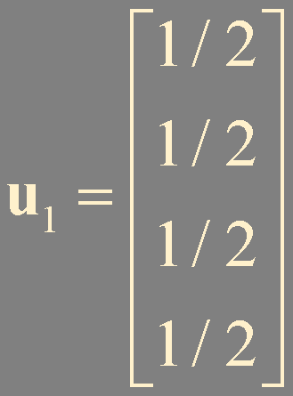
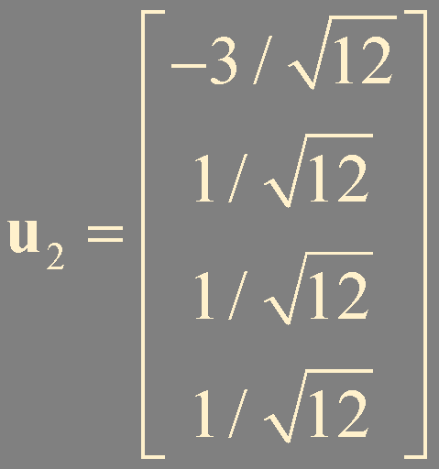
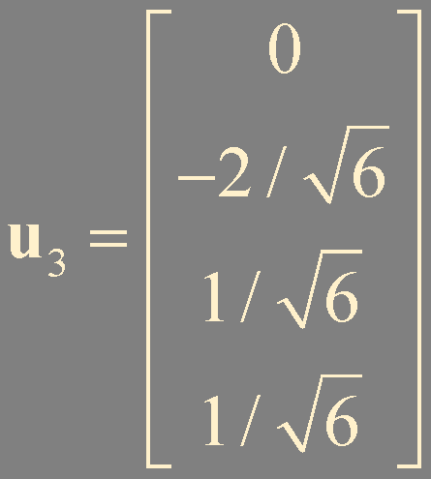
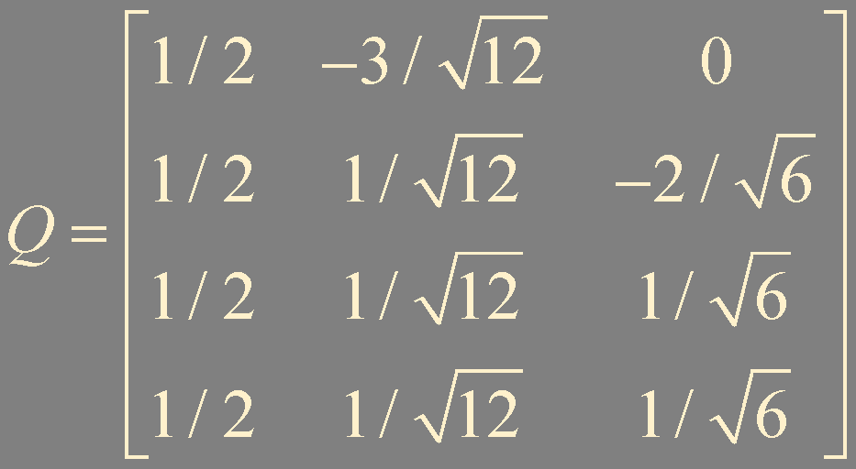
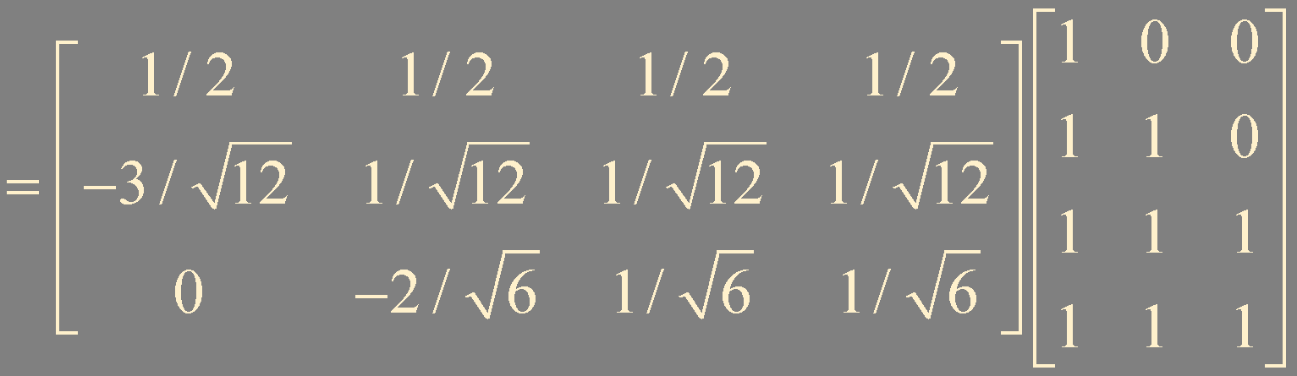
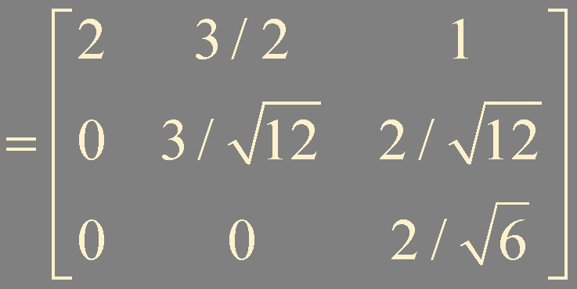
?
Example 4
Find a QR factorization of A =
v₁
v₃
R = Q^{T}A

Slide 13
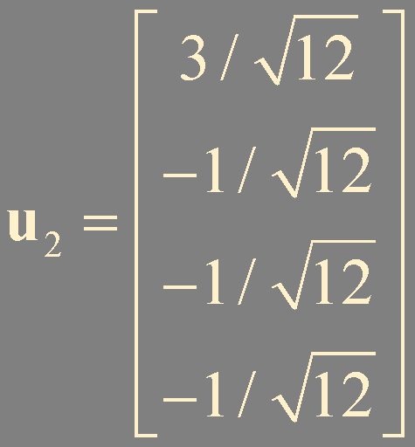
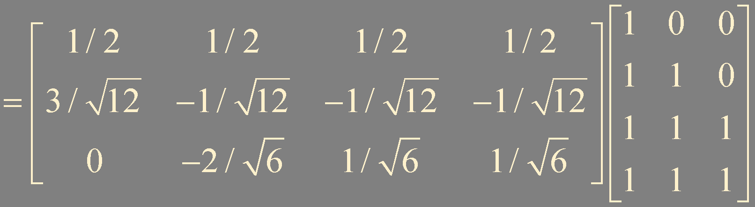
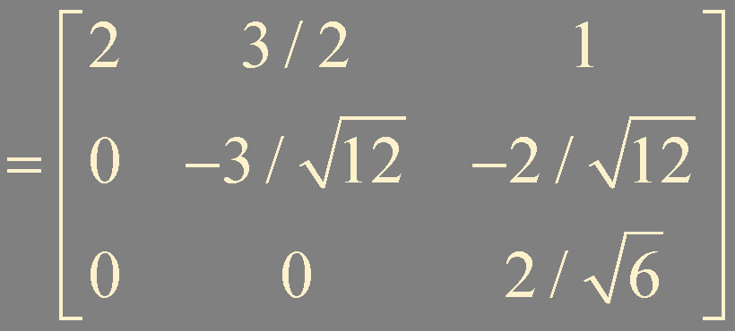
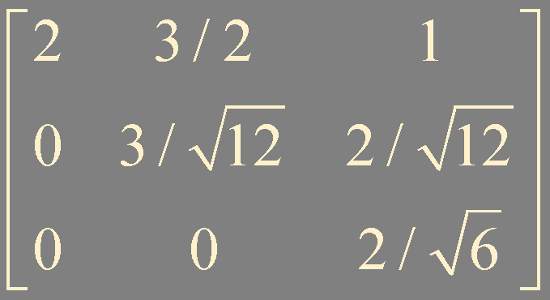
R = Q^{T}A
r₂₂ < 0 switch the sign of u₂, r₂₂ , and r₂₃

Slide 14
Summary
The Gram-Schmidt process
QR factorization

